Slide 1
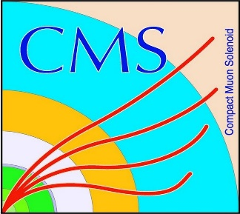

HEP Weekly Report
George Bakas
NTUA

Slide 2
Progress Report
DCS
fwInstallationUtils
Using the dbEditorAndNavigator tool to create projects using installations db
Want to implement ownership rights when using the tool
Bug fixes for the implementation of the tool
CmsFwInstallUtils
Checks between configuration db and the project
Tool is not “trustable” by users
Maybe we should revise on how the tool is implemented
Analysis
No spin correlation samples are almost at 77%
New Training
New substructure properties (energy correlation functions added and pT_{jet} / (Sum of all jet Pt’s)
Efficiencies are now better
ROC Curve and BDT output

